Slide 1
2021
MN State Convention
Memorial Service

Slide 2
They say there is a reason, They say that time will heal, But neither time nor reason, Will change the way we feel. For no-one knows the heartache, That lies behind our smiles, No-one knows how many times, We have broken down and cried. Gone from home that smiling face, Those cheerful, happy ways, The heart that won so many friends, In bygone, Happy days. We want to tell you something, So there won’t be any doubt, You’re so wonderful to think of, But so hard to be without. We cannot bring the old days back. When we were all together, The family chain is broken now, But memories live forever.

Slide 3
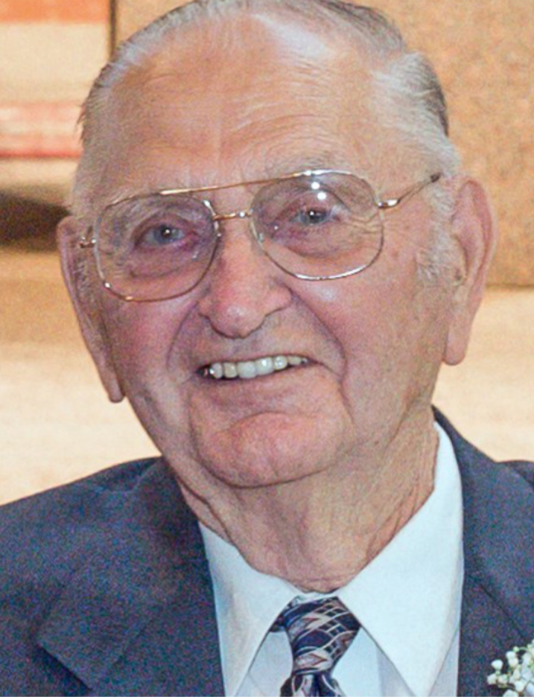
Maurice J. ‘Max’ Wenker
Max was born on March 17, 1926, and passed on January 12, 2021, at the age of 94.
He was a veteran of the U.S. Army and
served in the 96 th Infantry Division, known as the ‘Deadeyes’ during World War II.
Max was the Postmaster at the Freeport Post Office.
He enjoyed spending the winter months in Texas and spending time outdoors, fishing
and hunting, and playing cards, especially cribbage.
Blessed be his memory.

Slide 4
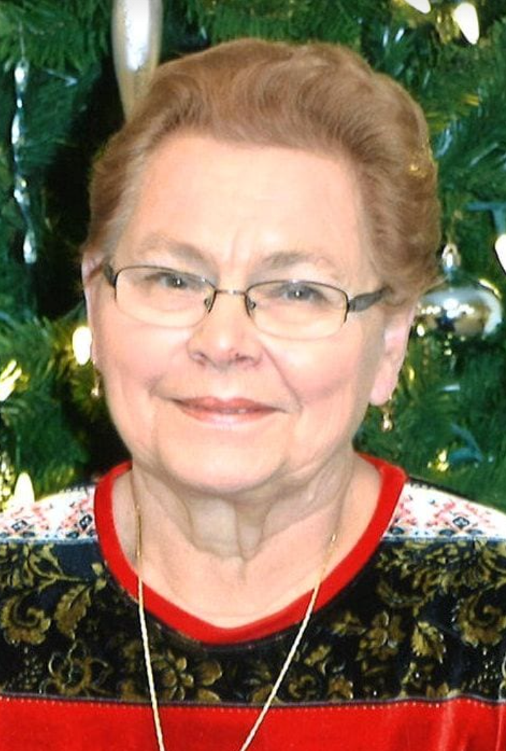
Mary Alice Hilde
Mary was born on July 12, 1942, and passed on October 19, 2020, at the age of 78.
She was the Postmaster at Hitterdahl and Ulen Post Offices.
Mary enjoyed many happy winters in Texas, playing cards, games and music and had a wonderful ability to grow beautiful flowers.
May she rest in peace.

Slide 5
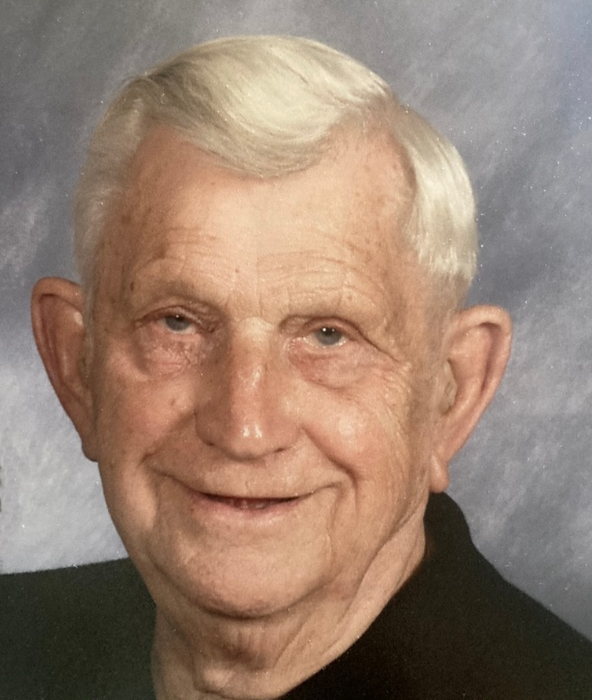
Anthony A. Markowski
Tony was born on July 5, 1929, and passed on January 20, 2021, at the age of 91.
He was a veteran of the U.S. Army and served in the Korean War as an auto mechanic.
He was the Postmaster at the Lakeland Post Office. Tony’s favorite winter destination was Gulf Shores Alabama and he enjoyed coffee outings, joking with the grandkids, puzzles, bingo and playing cards.
May he rest in peace.

Slide 6
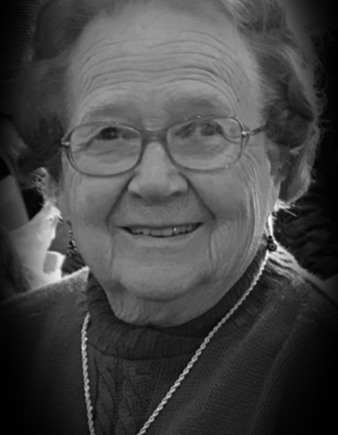
Geraldine ‘Gerry’ Leonard
Gerry was born on April 3, 1928, and passed on September 2, 2019, at the age of 91.
She was the Postmaster of the Nicolett Post Office.
Gerry volunteered her time at several places including St Peter State Hospital, Meals on Wheels, Bloodmobiles, and senior citizen driver.
Gerry was a member of the Nicollet Legion Auxiliary Post 510 and served as a bailiff for Nicollet County.
Gerry lived her life with purpose, and she was continually busy doing something for others. Of particular pride were the numerous quilts that she made for the homeless.
Each year she would donate between 40-50 quilts that she had sewn. Gerry enjoyed her flower gardens and took great pride in them.
Blessed be her memory.

Slide 7
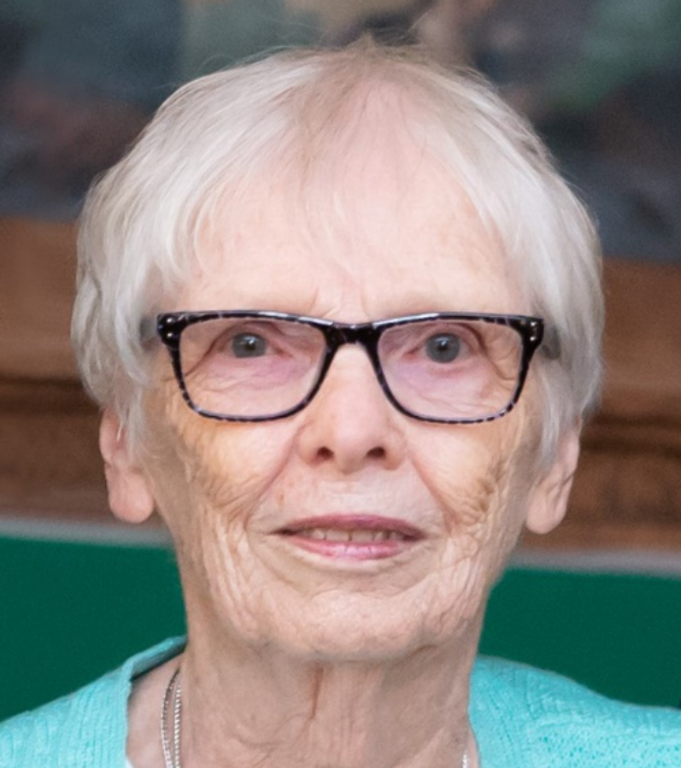
Patricia ‘Pat’ Ann Hansen
Pat was born on December 10, 1935, and passed on
April 26, 2021, at the age of 85.
She was the Postmaster at the Walnut Grove Post Office
and sister of retired Slayton Postmaster Mary Leonard.
Pat enjoyed playing cards, making quilts and reading. She
loved spending time with her family, especially her children,
grandchildren and great grandchildren.
Blessed by her memory.

Slide 8
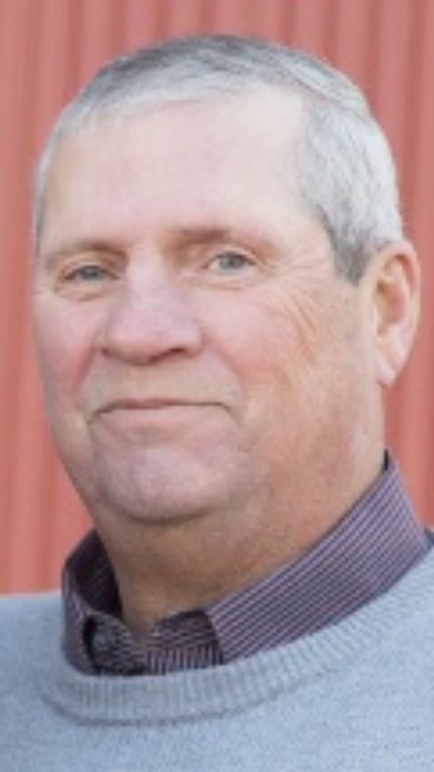
Rockford ‘Rocky’ Stangler
Rocky was born on December 17, 1953, and passed on May 15, 2021, at the age of 67.
He served as Postmaster in many communities and ended his career as the Postmaster of Montgomery.
Rocky enjoyed golfing, hunting, fishing, playing cards and entering his car in car shows. He loved spending time with his wife and daughters, his sons-in-law and grandchildren, as well as his beloved dog, Kasey.
May he rest in peace.

Slide 9
Dear Lord,
For these dear friends, and for any dear brother or sister that we may not have mentioned today, we take a moment of silence to honor them…..

Slide 10
How Great Thou Art
O Lord, my God, when I in awesome wonder
Consider all the worlds Thy Hands hath made
I see the stars, I hear the mighty thunder
Thy power throughout the universe displayed
Then sings my soul, my Saviour God, to Thee
How great Thou art, how great Thou art
Then sings my soul, my Saviour God, to Thee
How great Thou art, how great Thou art

Slide 11
And when I think that God, His Son not sparing
Sent Him to die, I scarce can take it in
That on the Cross, my burden gladly bearing
He bled and died to take away my sin
Then sings my soul, my Saviour God, to Thee
How great Thou art, how great Thou art
Then sings my soul, my Saviour God, to Thee
How great Thou art, how great Thou art

Slide 12
When Christ shall come with shout of acclamation
And take me home, what joy shall fill my heart
Then I shall bow in humble adoration
And there proclaim, my God, how great Thou art
Then sings my soul, my Saviour God, to Thee
How great Thou art, how great Thou art
Then sings my soul, my Saviour God, to Thee
How great Thou art, how great Thou art

Slide 13
Life is but a stopping place,
A pause in what’s to be,
A resting place along the road,
To sweet eternity.
We all have different journeys,
Different paths along the way,
We all were meant to learn some things,
But never meant to stay…
Our destination is a place,
Far greater than we know.
For some the journey’s quicker,
For some the journey’s slow.
And when the journey finally ends,
We’ll claim a great reward,
And find an everlasting peace,
Together with the Lord.
Amen

